Slide 1
DataStage Configuration Steps
Data Migration
From Netezza to Azure Synapse Analytics

Slide 2
Credits
Prepared by
Data Migration Jumpstart Engineering Team
Advanced Solutions Delivery – Data & AI CTO
askdmjfordmtools@microsoft.com
dmjarchitects@microsoft.com
Revision 2
3/26/2020

Slide 3
Disclaimer
This document is provided "as-is". Information and views expressed in this document, including URL and other Internet Web site references, may change without notice.
Some examples depicted herein are provided for illustration only and are fictitious. No real association or connection is intended or should be inferred.
This document does not provide you with any legal rights to any intellectual property in any Microsoft product. You may copy and use this document for your internal, reference purposes.
© 2020 Microsoft. All rights reserved.

Slide 4
Topics
Utilizing DataStage
Singleton and Bulk Load Inserts
Insert and Update data within Azure Synapse Analytics with DataStage
Changes to Transformers
Executing Azure Synapse Analytics Stored Procedures with DataStage
Large Data Ingestion in Azure Synapse Strategy
COPY INTO statement sample

Slide 5
Utilizing DataStage
A client DataStage application is installed on workstation/laptop (Designer)
Clicking on the Designer icon opens the DataStage application which requires authentication to the server with name, password and project name
Selection of a job is made from a tree structure on the left showing the jobs and sequences in hierarchical fashion

Slide 6
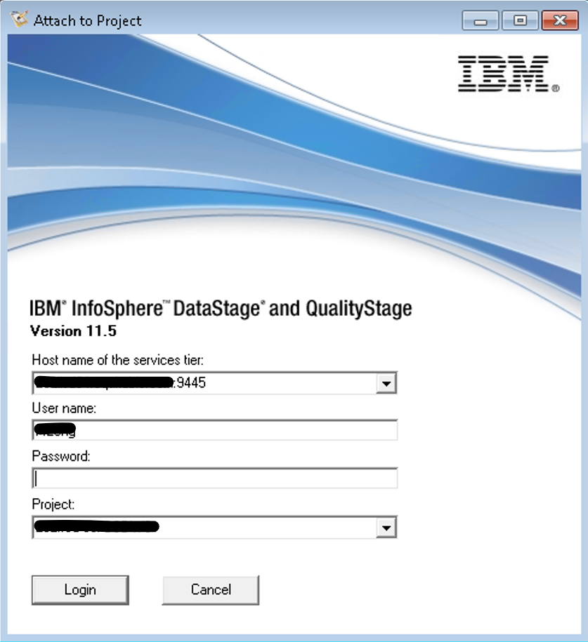
IBM InfoSphere DataStage Logon Screen
Notes:
InfoSphere DataStage is initiated from an icon on the desktop designated as "Designer"

Slide 7
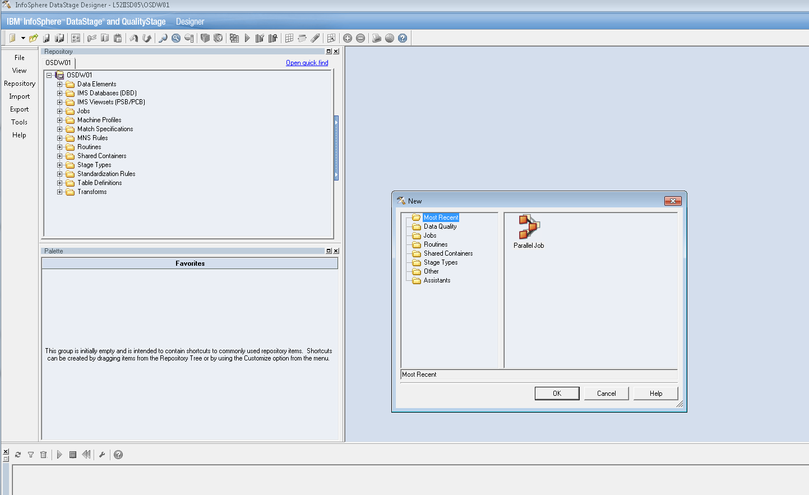
DataStage Initial Screen

Slide 8
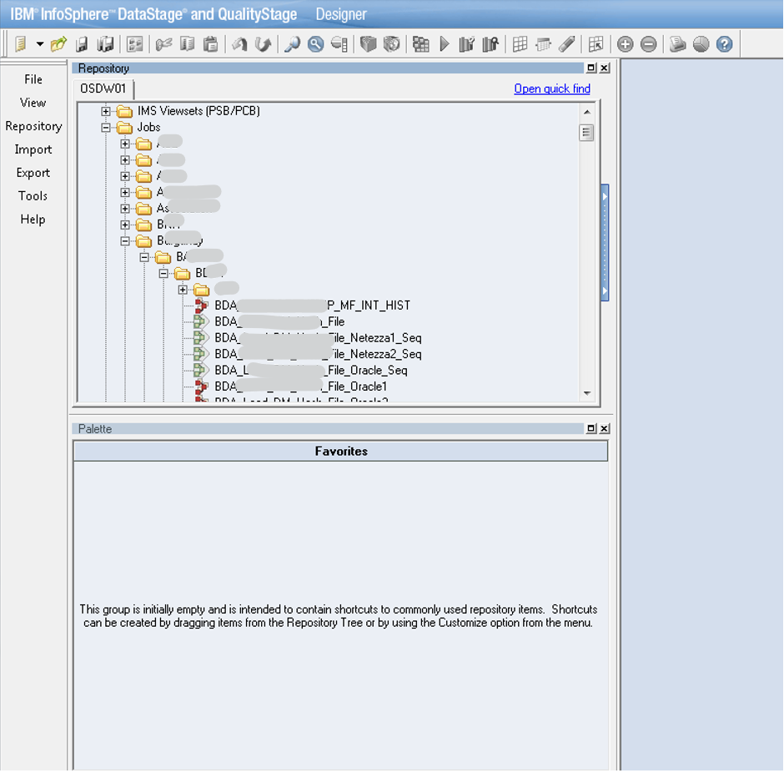
Select Job from the Project
Notes:
Click in the tree list for your final selection. The jobs that are designated in green are "sequence" jobs. These are job agents to select one or multiple jobs to run within the selection.

Slide 9
Working with the DataStage palette
On the left of the screen there are selections for the palette.
The Database category allows the user to select the connectivity type for this job.
The Processing category allows the user to select the type of processing to occur, i.e. transformer
The File category allows the user to select a type of target or source file (as opposed to a database) and requires no connectivity information

Slide 10
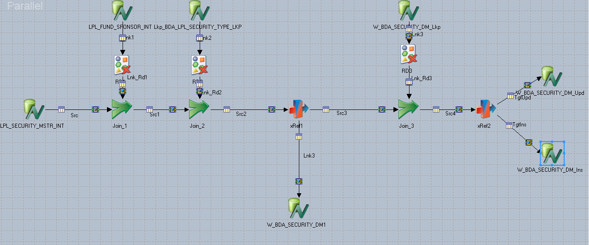
Sample Netezza Job – Update and Insert
Notes:
Example of Netezza job. This job both updates and inserts rows to a table that has a key in Netezza

Slide 11
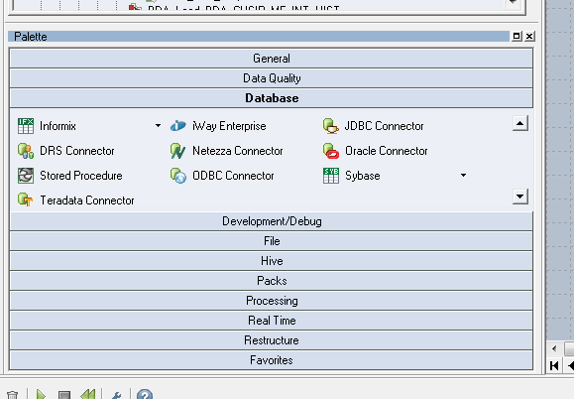
Selection for Connectivity of Available Sources/Targets
Notes:
Selection of ODBC Connector will only allow singleton transactions
Selection of DRS Connector will allow for selection of Bulk Insert option
All stored procedures run on Azure Synapse Analytics must be executed via the Stored Procedure Database option from this selection screen
Overview Use the DRS Connector stage to access relational database management systems by using the native interfaces that are available for the corresponding databases. The choice of the database type is not determined when the stage is placed on the job canvas but is instead specified when the stage is configured.
Configuration The DRS Connector stage supports IBM® DB2®, Oracle, and ODBC data sources. For other database types, you can configure the DRS Connector stage to use the ODBC database type and access the databases through the ODBC drivers that are included with InfoSphere Information Server.
Settings for the DRS Connector stage After the DRS Connector stage is placed on the job canvas, it needs to be configured to perform the operation intended by the job design.
Defining a DRS Connector stage connection to the database When a new DRS Connector stage is added to the server or parallel canvas, you must specify the connection information for the database that the stage connects to at run time.

Slide 12
Singleton and Bulk Load Inserts
Selection of ODBC Connector will only allow singleton transactions
Selection of DRS Connector will allow for selection of Bulk Insert option
All stored procedures run on Azure Synapse Analytics must be executed via the Stored Procedure Database option from this selection screen

Slide 13
DRS Connection
Use the DRS Connector stage to access relational database management systems by using the native interfaces that are available for the corresponding databases.
The choice of the database type is not determined when the stage is placed on the job canvas but is instead specified when the stage is configured.
The DRS Connector stage supports IBM® DB2®, Oracle, and ODBC data sources. For other database types, you can configure the DRS Connector stage to use the ODBC database type and access the databases through the ODBC drivers that are included with InfoSphere Information Server.
After the DRS Connector stage is placed on the job canvas, it needs to be configured to perform the operation intended by the job design.
When a new DRS Connector stage is added to the server or parallel canvas, you must specify the connection information for the database that the stage connects to at run time.
Information Links
DRS Connection Overview
DRS Configuration
Settings for the DRS Connector stage
Defining a DRS Connector stage connection to the database

Slide 14
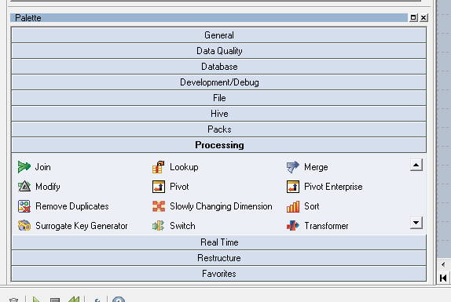
Selection of Choices for Processing
Used More Often
Notes:
Transformer – most often used

Slide 15
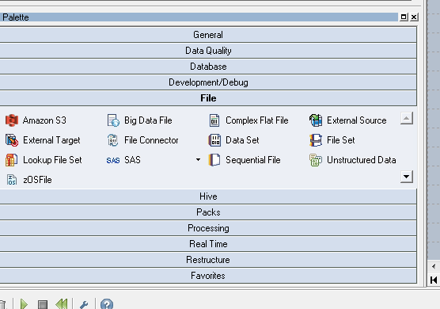
Selection of File Options

Slide 16
Setup Database Tables for use
Any Database table(s) used in this job must be imported into the job
Every table that is used in the job must be imported individually.
The name used to set up the ODBC connectivity for the database is utilized in the "DSN Name" box
Authorization credentials are specified in each individual import stage

Slide 17
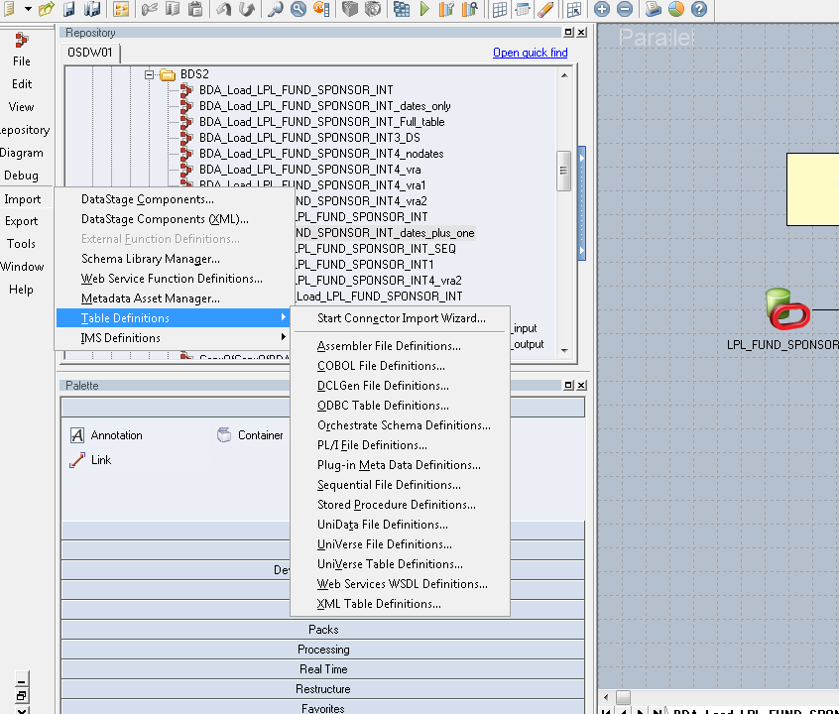
Import Table Selections
Notes:
Every table that is used in the job must be imported individually. Select Import / Table Definitions / Orchestrate Schema Definitions.

Slide 18
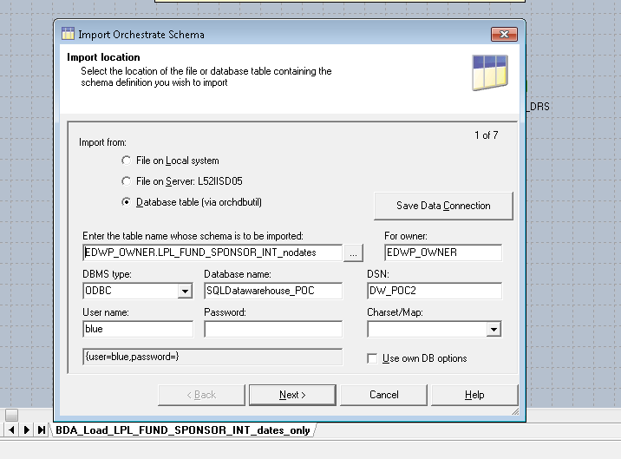
Import each table used
The database schema must be included in the table import along with the username and password.
Notes:
The database schema must be included in the table import along with the username and password.

Slide 19
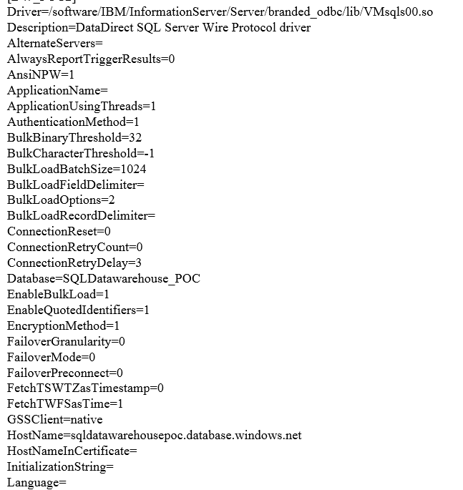
DataStage ODBC.ini driver parameters
In order to utilize the Bulk Load option, the EnableBulkLoad parameter must be set to 1.
Notes:
In order to utilize the Bulk Load option, the "EnableBulkLoad" parameter must be set to 1.

Slide 20
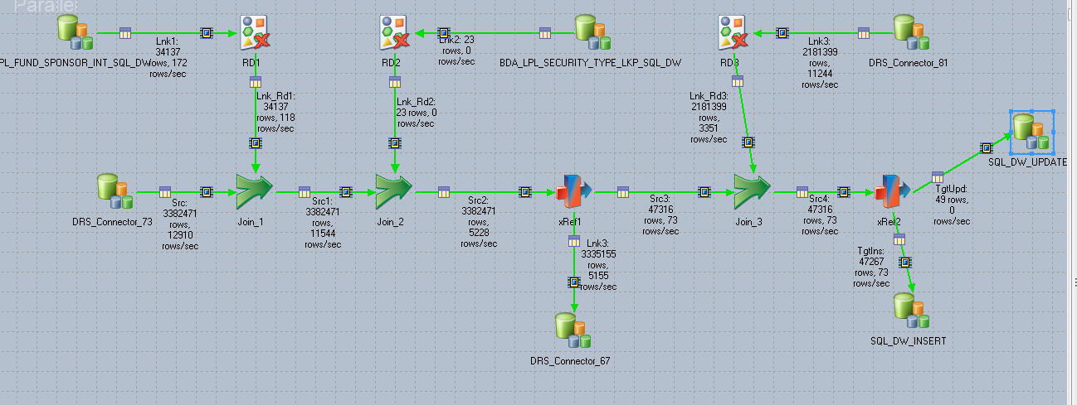
Converted Sample Job – Update and Insert
Notes:
Converted all Netezza sources and targets to Azure Synapse Analytics

Slide 21
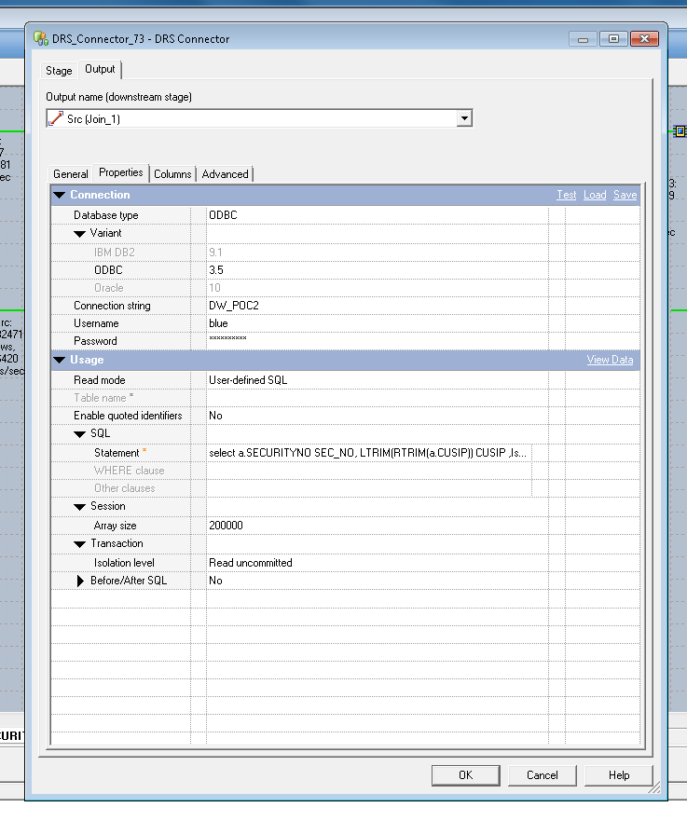
Utilize same method of pulling information
Data pulled by "user defined SQL" statement.
Notes:
Utilize same method of pulling information. In this example, data is being pulled by "user defined SQL" statement.

Slide 22
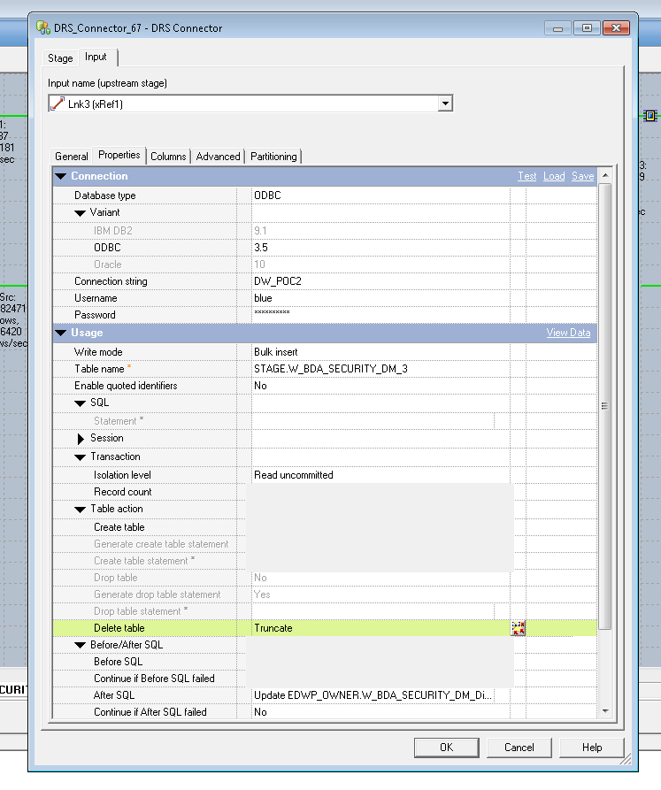
For updating data, first, ingest into staging table using Bulk Insert.
Load into Stage Table
Update as an After SQL
Notes:
In order to update data, the data must first be loaded into a staging table (as designated in the table name) using a "Bulk Insert" statement in the "write mode" column. The update SQL statement is placed in the After SQL box at the bottom. This will allow the Bulk Insert statement to load the data to the staging table represented in the Table Name box and then will process the update after all the data has reached the staging table.

Slide 23
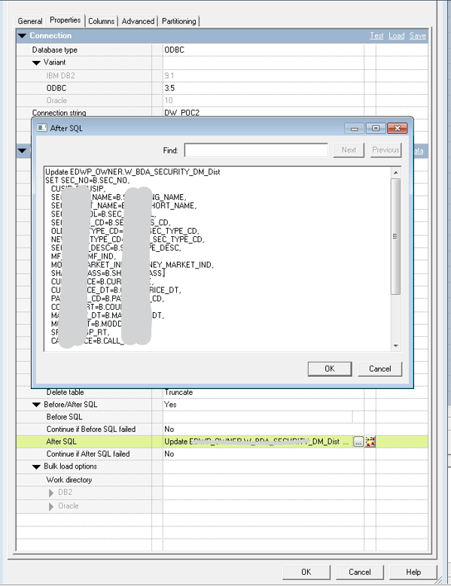
Detail example of the Update statement.
Notes:
Detail example of the Update statement.

Slide 24
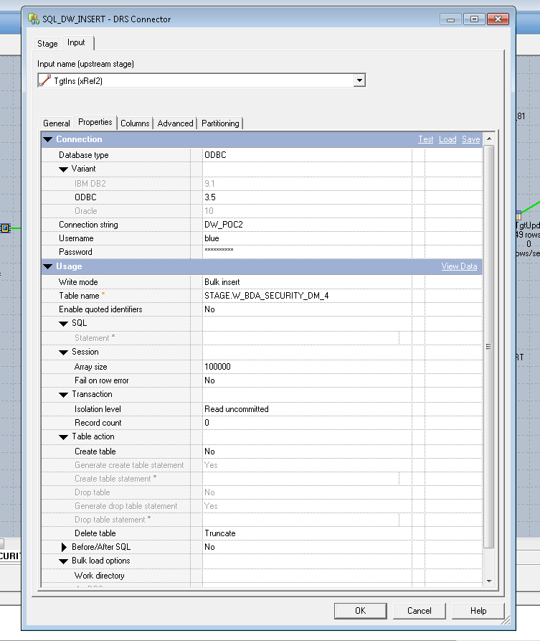
Similar approach to Insert
Load into Stage Table
Notes:
The same process is used for the Insert as the Update. In this example, a Bulk Insert is utilized to load data into a staging table. The Truncate table is utilized to assure that all data has been cleared from the staging table prior to the insert.

Slide 25
Changes to Transformers
When changing the sources and targets, assure that you are replacing the existing stages by deleting them and then pasting the new ones in.
Do not delete the connection arrows.
Open each Transformer processing module and change necessary sources and/or targets information

Slide 26
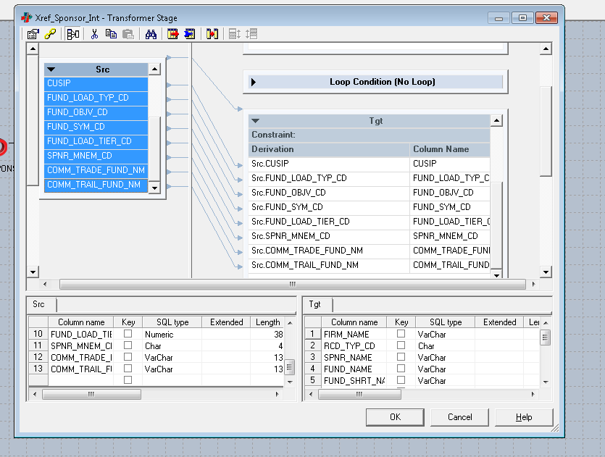
Change Transformer Processor

Slide 27
Executing Stored Proc on Azure Synapse Analytics
If an additional step is required to creating a sequence
Create the stored procedure on Azure Synapse Analytics SQL Pool
Create a job to execute the stored procedure
Set up a "Sequence" job to execute the job that inserts and updates and then executes the stored proc

Slide 28
Stored Procedure to Build Key and Insert
CREATE PROCEDURE STAGE_INSERT AS
BEGIN
DECLARE @security_id bigint
Select @security_id = MAX(ROW_ID) FROM SAMPLE_SCHEMA.W_BDA_SECURITY_DM_Dist
--
if Exists(select 1 from sys.tables where name = 'W_BDA_SECURITY_DM_4_ROWNUM') Drop Table STAGE.W_BDA_SECURITY_DM_4_ROWNUM
create table STAGE.W_BDA_SECURITY_DM_4_ROWNUM
with (distribution = replicate, heap) as
select (@security_id +row_number() over(order by sec_no, cusip asc)) as NEW_ROW_NUM,
SEC_NO, CUSIP,
SEC_LONG_NAME,
SEC_SHORT_NAME,
SEC_SYMBOL,
SEC_CLASS_CD,
OLD_SEC_TYPE_CD,
NEW_SEC_TYPE_CD,
SEC_TYPE_DESC,
MF_IND,MONEY_MARKET_IND,SHARE_CLASS,CURR_PRICE,CURR_PRICE_DT,PAY_FREQ_CD,COUPON_RT,MATURITY_DT
,MODDY_RT,SP_RT,CALL_PRICE,DIVIDEND,FACTOR_DT,FACTOR,NOTE,INTEGRATION_TSTP
FROM STAGE.W_BDA_SECURITY_DM_4
INSERT INTO SAMPLE_SCHEMA.W_BDA_SECURITY_DM_Dist
(ROW_ID,
SEC_NO,
CUSIP,
SEC_LONG_NAME,
SEC_SHORT_NAME,
SEC_SYMBOL,
SEC_CLASS_CD,
OLD_SEC_TYPE_CD,
NEW_SEC_TYPE_CD,
SEC_TYPE_DESC,
MF_IND,MONEY_MARKET_IND,SHARE_CLASS,CURR_PRICE,CURR_PRICE_DT,PAY_FREQ_CD,COUPON_RT,MATURITY_DT,
MODDY_RT,SP_RT,CALL_PRICE,DIVIDEND,FACTOR_DT,FACTOR,NOTE,INTEGRATION_TSTP
)
SELECT
B.NEW_ROW_NUM, B.SEC_NO, B.CUSIP, B.SEC_LONG_NAME,
B.SEC_SHORT_NAME, B.SEC_SYMBOL,
B.SEC_CLASS_CD, B.OLD_SEC_TYPE_CD, B.NEW_SEC_TYPE_CD, B.SEC_TYPE_DESC, B.MF_IND, B.MONEY_MARKET_IND,
B.SHARE_CLASS, B.CURR_PRICE, B.CURR_PRICE_DT, B.PAY_FREQ_CD, B.COUPON_RT, B.MATURITY_DT,
B.MODDY_RT, B.SP_RT, B.CALL_PRICE, B.DIVIDEND, B.FACTOR_DT, B.FACTOR, B.NOTE, B.INTEGRATION_TSTP
FROM STAGE.W_BDA_SECURITY_DM_4_ROWNUM B
END
Stage Table with sequencer
Target Table

Slide 29
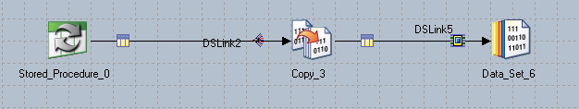
DataStage – Job to Execute Stored Procedure
Notes:
This is the process by which a Stored Procedure is executed.

Slide 30
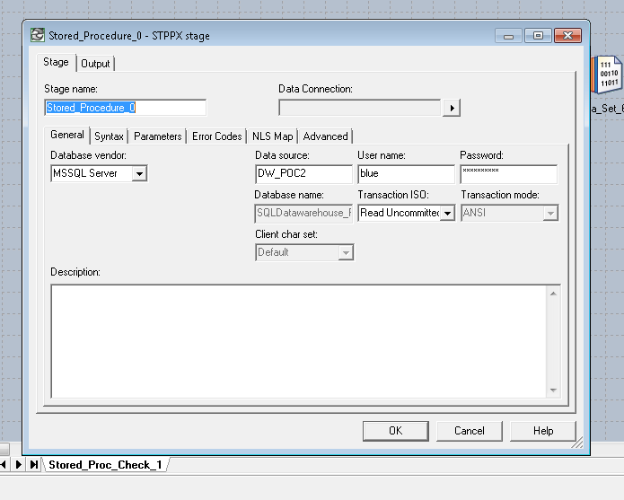
Stored Proc General Setup
Notes:
This slide shows the Stored Proc is setup for execution on Azure Synapse Analytics.

Slide 31
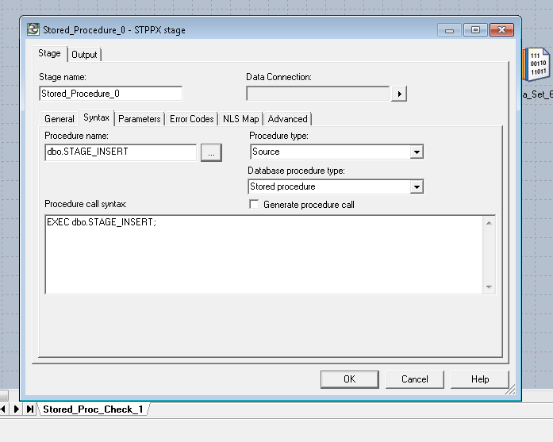
Set Up Syntax for Stored Proc Exec
Azure Synapse Stored Procedure Name
T-SQL Stored Procedure Call
Notes:
The Procedure Name is the name of the stored proc on Azure Synapse Analytics. The Procedure Call Syntax shows the execute statement for the stored proc.

Slide 32
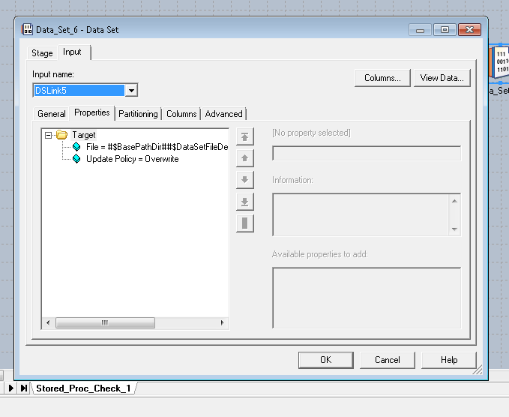
Set up "Copy" process Input Properties
Notes:
The properties set up here were defaulted on creation of this process.

Slide 33
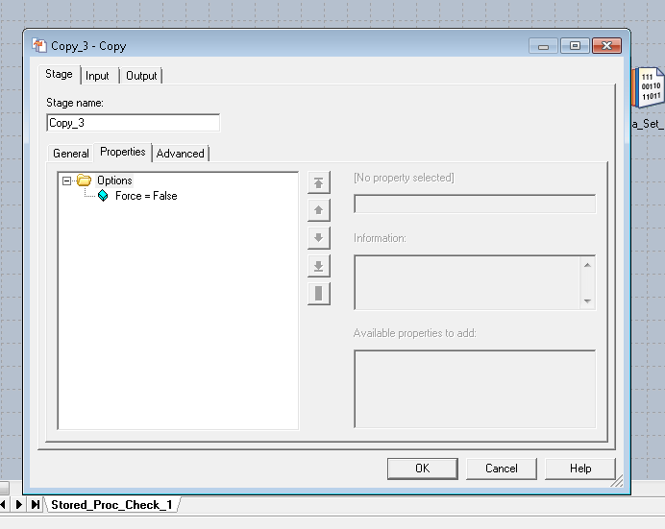
Set up "Copy" Process Output Properties for Stored Proc

Slide 34
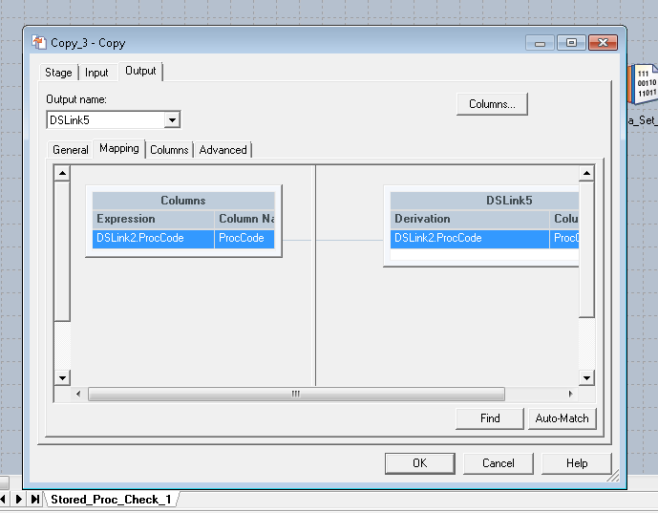
Set up "Copy" process for Output Mapping

Slide 35
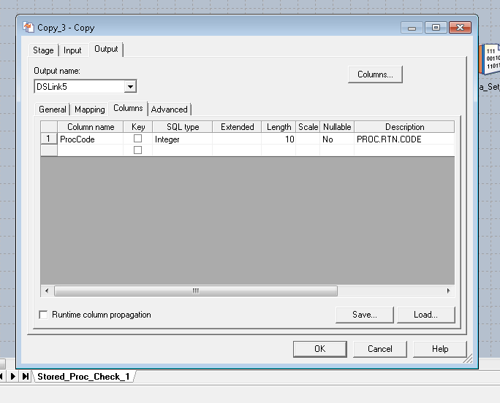
Set up "Copy" process Output Columns

Slide 36
Large Data Ingestion in Azure Synapse Strategy
Large Data Set ingestion should follow a pattern
Land data intro Azure Blob Container or Data Lake Store
Ingest into a staging table in Azure Synapse Analytics using COPY INTO
CTAS or Insert into Final Table
Refresh statistics as needed
DataStage can orchestrate the reading from source (e.g. flat files) and ingesting into Blob Storage as a first step
COPY INTO
Azure Blob / Data Lake Store
Azure Synapse Analytics SQL Pool

Slide 37
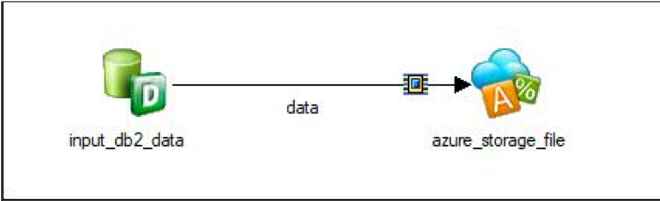
Writing Data Into Azure Storage with DataStage
Large Data Set ingestion can take advantage of COPY INTO process from Azure Synapse Analytics from data landed in Blob Storage
Requirements: IBM Infosphere Information Server Datastage 11.7fp1 and above
High Level Steps:
Configure Azure Storage Connector Connection Properties
Configure Azure Storage Connector to write to Azure Blob Storage
Additional Configuration for Parallel Write
Documentation Link

Slide 38
Bulk Loading into Azure Synapse with DataStage
COPY INTO statement can be executed:
Within a Stored Procedure
Or as an ad-hoc T-SQL
COPY INTO will take the data from Blob Storage/ADLS and ingest into Azure Synapse Analytics in parallel
Data should be landed on an uncompressed rowstore table for performance reasons
T-SQL should execute a last step of ingesting or CTAS into a final table.
Recompute of statistics is always recommended when data has changed significantly

Slide 39
Bulk Loading with COPY INTO statement
No compression
CREATE SCHEMA stage;
-- Create the Staging Table
-- Drop Table [stage].[SalesData]
Create table [stage].[SalesData](
Region varchar(50)
,Product varchar(50)
,SaleDate date
,Amount DECIMAL (20,10)
)
with (distribution = round_robin, HEAP);
/* Documentation
https://docs.microsoft.com/en-us/sql/t-sql/statements/copy-into-transact-sql?view=azure-sqldw-latest
*/
COPY INTO [stage].[SalesData] (Region 1, Product 2, SaleDate 3, Amount 4)
FROM 'https://acccount.blob.core.windows.net/yourcontainer'
WITH (
FILE_TYPE = 'CSV',
CREDENTIAL=(IDENTITY= 'Shared Access Signature', SECRET='Your secret here’),
FIELDQUOTE = '“’,
FIELDTERMINATOR=',’,
ROWTERMINATOR = '\n',
Identity_INSERT = 'OFF',
ENCODING = 'UTF8',
DATEFORMAT = 'ymd',
FIRSTROW = 2
);
CREATE SCHEMA Sales;
-- CTAS with HASH distribution on Date and Columnar format
-- DROP TABLE Sales.Transactions
CREATE TABLE Sales.Transactions
WITH
(
DISTRIBUTION = HASH(SaleDate)
,CLUSTERED COLUMNSTORE INDEX
) AS SELECT * FROM [stage].[SalesData];
Create Statistics stat_stage_salesdata_Region on Sales.Transactions (Region) with fullscan;
Create Statistics stat_stage_salesdata_Product on Sales.Transactions (Product) with fullscan;
Create Statistics stat_stage_salesdata_SaleDate on Sales.Transactions (SaleDate) with fullscan;
Create Statistics stat_stage_salesdata_Amount on Sales.Transactions (Amount) with fullscan;
Not necessary if using AAD / Role based access control
CTAS into final table, with compression and distribution
Statistics are created

